Slide 1
Real-Time Ticketing
Score My Team

Slide 2
Real-Time Ticketing
Real-Time Ticketing is an evaluation of your ability to enter tickets and information into ConnectWise in Real-Time.
The evaluation is performed by an automated application.
This is the easiest area to excel in; all you need to do is keep ConnectWise in Real-Time with the work you are performing.
The following tutorial will describe the process that will score you the highest points possible in this area.

Slide 3
Real-Time Ticketing
All calls or tickets you receive should result in a ticket being placed “In Progress”, a Resource record being created for yourself at the exact time of the call and, when done with the ticket or call, a time entry created.

Slide 4
Real-Time Ticketing

Slide 5
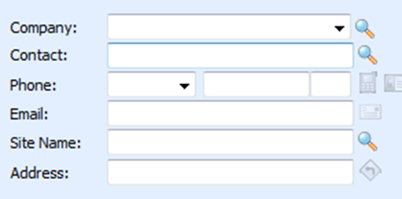
Real-Time Ticketing
Verify that the Company, Contact, Phone Number (for the ticket) and Email are assigned and correct.
Ensure that you have the correct Site Name and Address for this issue.

Slide 6
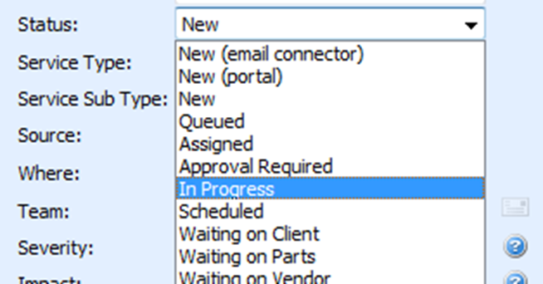
Real-Time Ticketing
Change Status to “In Progress”

Slide 7
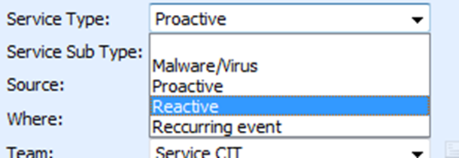
Real-Time Ticketing
Change Service Type to “Reactive” or “Malware/Virus”

Slide 8
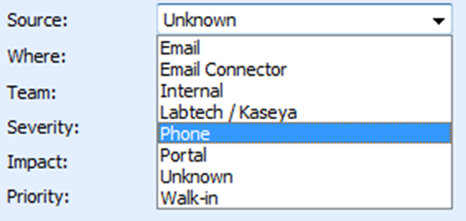
Real-Time Ticketing
Select appropriate Source.

Slide 9
Real-Time Ticketing
By selecting the appropriate Severity and Impact, the Priority will automatically be updated.

Slide 10
Real-Time Ticketing
The Summary needs to be clear and to the point on the issue.
The Detail Description can be long or short, as long as ALL necessary information is provided.

Slide 11
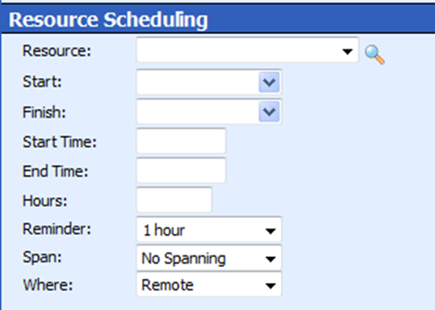
Real-Time Ticketing
Schedule yourself as the Resource with the start time set to the start of the phone call or work. Do not round up or down on your start time.
Click the Save icon. Until you click Save none of the information is in ConnectWise.

Slide 12
Real-Time Ticketing
Click on the Configurations tab and add all relevant Configurations.
You may need to add more Configurations as your work continues on the ticket.

Slide 13
Real-Time Ticketing
When you have concluded your work, either by completing the ticket or completing as much as you can up to that point, click the Timer icon next to Detail Description.

Slide 14
Real-Time Ticketing
Check “Done with this scheduled event”.
Check the appropriate “Add notes to:”.
Check the appropriate “Email Options:”.
“Enter Time Record” should be checked.

Slide 15
Real-Time Ticketing
Set your Start and End Time.
Write detailed notes for the work performed.

Slide 16
Real-Time Ticketing
If you have stopped working on the ticket, it must be taken out of “In Progress” and moved to an appropriate Status.
When moving the Status to “Assigned” or “Scheduled”, a Resource with a specific Date and Time must be assigned. Do not reuse an old Schedule entry to assign future work.
When moving to a “Waiting on…” status, a Resource with at least a specific Date must be assigned.

Slide 17
Real-Time Ticketing Tips
Creating new Configurations as well as adding existing ones to a ticket is an easy way to accrue points. The time spent creating the new Configuration should also go against the ticket.
This is Real-Time. You will have points deducted when entering information in “soon enough” or “pretty close to Real-Time”.

Slide 18
Points Glossary
The following glossary explains the meaning of the different Real-time Ticketing Points assignment. The points associated with each term is broken down by (Service Ticket / Project Ticket or work performed on-site / Monitoring, Sales & Other Ticket Types).
IN_PROGRESS (+16/+48/+8)
The ticket was in the “We have created a Resolution Plan” SLA Escalation Status (“In Progress”) and a time entry exists that matches the duration of the “In Progress” state within 8 minutes of start of work and within 15 minutes of end of work. Only awarded once per day per ticket per tech.
IN_PROGRESS_MISSING (-8/-8/-4)
Points lost if “We have created a Resolution Plan” SLA Escalation Status (“In Progress”) is not used when work is being performed

Slide 19
Points Glossary
IN_PROGRESS_TOO_LONG (-16/-16/-8)
Ticket left in “In Progress” 15 minutes longer than actual work performed
IN_PROGRESS_TOO_EARLY_OR_LATE (-16/-16/-8)
Points lost if ticket is moved to “In Progress” and work is not started until later time or if work is started and status is not changed to “In Progress” more than 8 minutes of start of work or 15 minutes of end of work
IN_PROGRESS_LONGER_THAN_ACTUAL_WORK (-16/-16/-8)
Applied if more than 0.25 hours of actual work performed but more than 1/3 of the time was deducted. It is preferred the ticket come out of “In Progress” if that much time was needed to be deducted

Slide 20
Points Glossary
CONFIGURATION_ATTACHED_DURING_BILLABLE (+8/+24/+4)
Attaching configurations to a ticket during a billable time entry
CONFIGURATION_ATTACHED_DURING_NONBILLABLE (+4/+12/+2)
Attaching configurations to a ticket during a non-billable time entry
CONFIGURATION_ATTACHED_NO_TIME (+4/+12/+2)
Attaching configurations to a ticket when no time entry exists for the time of attachment

Slide 21
Points Glossary
SOURCE_PHONE (+8/+24/+4)
Points granted when the ticket source is set to Phone when generating a new ticket
SOURCE_NOT_SET (-8/-8/-4)
Ticket source not set (where ticket is being generated from i.e. e-mail, phone, on-site etc.). Only applied if default Source value is “Change Me”.
SERVICE_TYPE_NOT_SET (-8/-8/-4)
Ticket service type not set (working on printer, workstation, network etc.). Only applied if default Service Type value is “Change Me”.

Slide 22
Points Glossary
TIMELY_TIME_ENTRY (+4/+12/+2)
Entered billable time within 5 minutes of completing work
UNTIMELY_TIME_ENTRY (-8/-8/-4)
Time entry was entered for a ticket over 15 minutes after actual work performed
UNTIMELY_NOTES (-8/-8/-4)
Notes are added to the time entry over 15 minutes after actual work performed
BLANK_TIME_ENTRY (-8/-8/-4)
Billable, non-travel time entry without notes

Slide 23
Points Glossary
QUICK_TICKET_START (+8/+8/+4)
Ticket creation and placed “In Progress” within 5 minutes of each other
COMPLETED (+8/+24/+4)
Ticket moved to “We have resolved the issue” SLA Escalation
REOPENED (-16 /-16/ -8)
Points deducted if new work is performed on a ticket re-opened after being closed

Slide 24
End

